Slide 1
Digital Signatures
Public-key encryption provides a method for doing digital signatures
To sign a message, M, Alice just encrypts it with her private key, SA, creating C = E_{SA}(M).
Anyone can decrypt this message using Alice’s public key, as M’ = D_{PA}(C), and compare that to the message M.

Slide 2
Cryptographic Hash Functions
A checksum on a message, M, that is:
One-way: it should be easy to compute Y=H(M), but hard to find M given only Y
Collision-resistant: it should be hard to find two messages, M and N, such that H(M)=H(N).
Examples: SHA-1, SHA-256.

Slide 3

Message Authentication Codes
Allows for Alice and Bob to have data integrity, if they share a secret key.
Given a message M, Alice computes H(K||M) and sends M and this hash to Bob.
Communication channel
(attack detected) =?
h
6B34339
4C66809
4C66809
87F9024
h
message M
MAC
MAC
received MAC
computed MAC
message M’
shared
secret
key
shared
secret
key
Sender
Attacker
(modifying)
Recipient

Slide 4
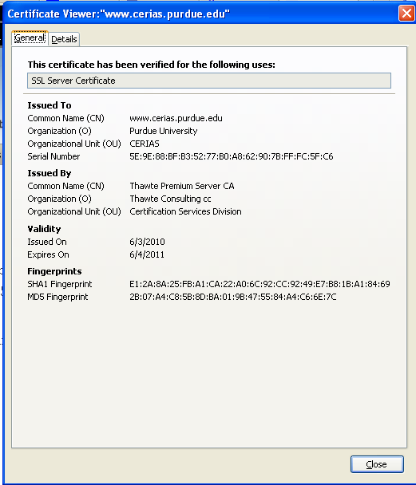
Digital Certificates
certificate authority (CA) digitally signs a binding between an identity and the public key for that identity.

Slide 5
Passwords
A short sequence of characters used as a means to authenticate someone via a secret that they know.
Userid: _________________
Password: ______________

Slide 6
How a password is stored?
User
Password file
Dog124
Butch:ASDSA
21QW3R50E
ERWWER323
…
…
hash function

Slide 7
Strong Passwords
What is a strong password
UPPER/lower case characters
Special characters
Numbers
When is a password strong?
Seattle1
M1ke03
P@$$w0rd
TD2k5secV
7
Notes:
7
7
Spostare in altra sezione

Slide 8
Password Complexity
A fixed 6 symbols password:
Numbers 10⁶ = 1,000,000
UPPER or lower case characters 26⁶ = 308,915,776
UPPER and lower case characters 52⁶ = 19,770,609,664
32 special characters (&, %, $, £, “, |, ^, §, etc.) 32⁶ = 1,073,741,824
94 practical symbols available
94⁶ = 689,869,781,056
ASCII standard 7 bit 2⁷ =128 symbols
128⁶ = 4,398,046,511,104
8

Slide 9

Password Length
26 UPPER/lower case characters = 52 characters
10 numbers
32 special characters
=> 94 characters available
5 characters: 94⁵ = 7,339,040,224
6 characters: 94⁶ = 689,869,781,056
7 characters: 94⁷ = 64,847,759,419,264
8 characters: 94⁸ = 6,095,689,385,410,816
9 characters: 94⁹ = 572,994,802,228,616,704
9
Notes:
9
9

Slide 10
Password Validity: Brute Force Test
Password does not change for 60 days
how many passwords should I try for each second?
5 characters: 1,415 PW /sec
6 characters: 133,076 PW /sec
7 characters: 12,509,214 PW /sec
8 characters: 1,175,866,008 PW /sec
9 characters: 110,531,404,750 PW /sec
10
Notes:
10
10

Slide 11
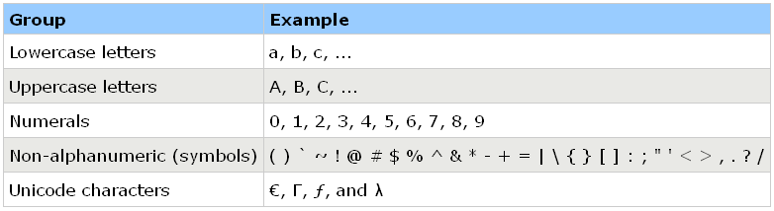
Secure Passwords
A strong password includes characters from at least three of the following groups:
Use pass phrases eg. "I re@lly want to buy 11 Dogs!"
11

Slide 12
Social Engineering
Pretexting: creating a story that convinces an administrator or operator into revealing secret information.
Baiting: offering a kind of “gift” to get a user or agent to perform an insecure action.
Quid pro quo: offering an action or service and then expecting something in return.

